Slide 1
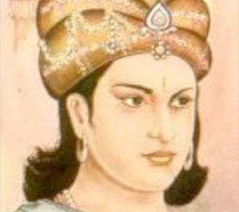
ATOMIC ENERGY CENTRAL SCHOOL , NARORA
MODULE ½
HISTORY
CHAPTER 8
ASHOKA ,THE EMPEROR WHO GAVE UP WAR
BY- Abhilasha chauhan
TGT ENGLISH
(Ad hoc )

Slide 2
OUR PASTS
CHAPTER 8-
ASHOKA ,THE EMPEROR WHO GAVE UP WAR
MODULE 1/2

Slide 3
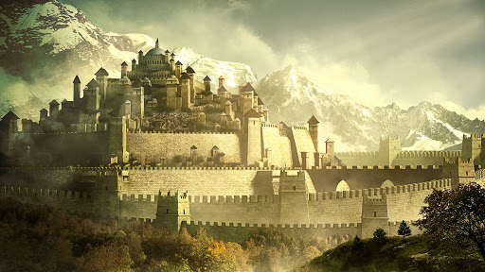
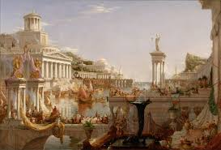
KINGDOM
EMPIRE
KINGDOM IS RULED BY A KING.
IT IS SMALLER THAN EMPIRE IN AREA.
REQUIRE LESS NUMBER OF OFFICIALS AND RESOURCES.
EMPIRE IS RULED BY AN EMPEROR.
IT IS LARGER THAN THE KINGDOM IN AREA.
REQUIRE LARGE NUMBER OF OFFICIALS AND RESOURCES.

Slide 4
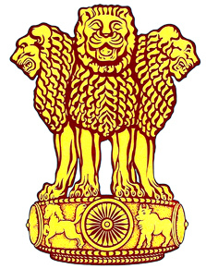
ASHOKA, THE EMPEROR
Ashoka was one of the greatest ruler known to history
Inscriptions were carved on pillars as well as on rock surfaces in sarnath on the instructions of Ashoka.

Slide 5
DYNASTY
WHEN MEMBERS OF SAME FAMILY BECOME RULERS ONE AFTER ANOTHER , THE FAMILY IS OFTEN KNOWN AS DYNASTY.

Slide 6
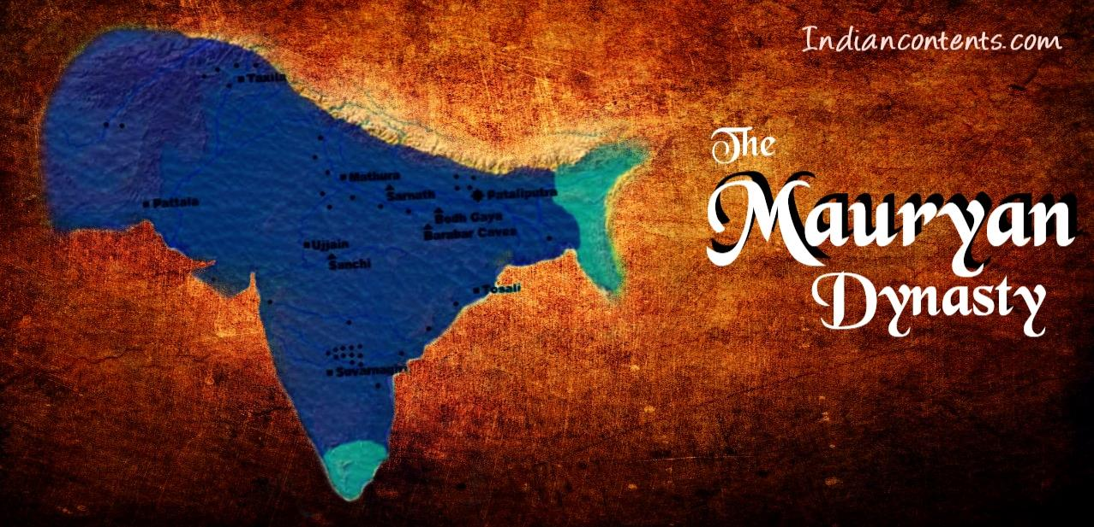
MAURYAN DYNASTY
CHANDRAGUPTA
BINDUSARA
ASHOKA

Slide 7
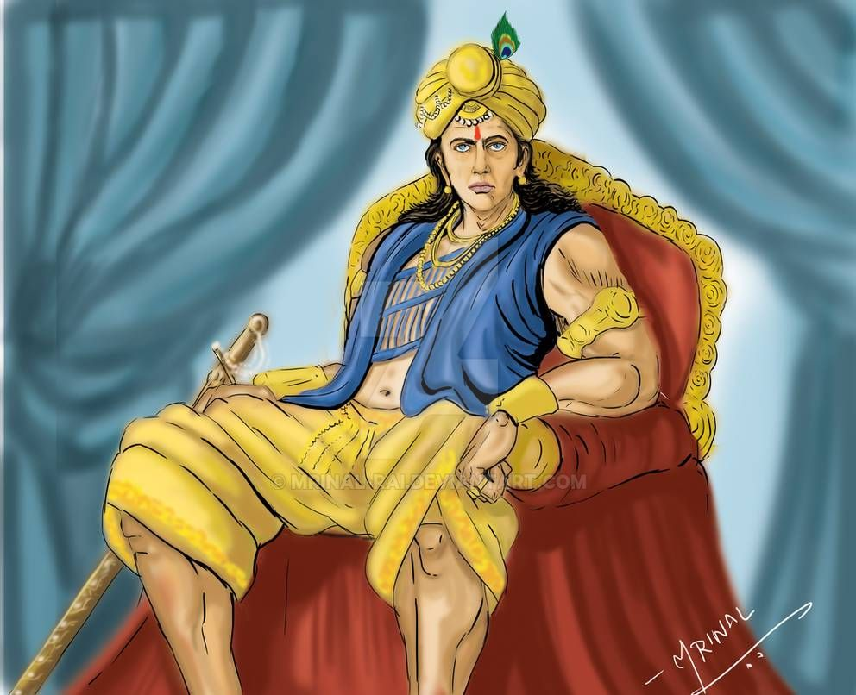
CHANDRAGUPTA FOUNDED THE DYNASTY 2300 YEARS AGO.
HE WAS SUPPORTED BY A WISE MAN NAMED CHANAKYA OR KAUTILYA.

Slide 8
THERE WERE THREE CAPITAL CITIES IN THE EMPIRE.
PATLIPUTRA (PRESENT DAY PATNA)
TAXILLA( GATEWAY TO NORTHERN INDIA AND CENTRAL ASIA)
UJJAIN(ON THE ROUTE FROM NORTH TO SOUTH INDIA)

Slide 9
TRIBUTE
WAS COLLECTED ON A REGULAR BASIS , UNLIKE TAXES.
IT WAS COLLECTED AS AND WHEN IT WAS POSSIBLE FROM PEOPLE WHO GAVE A VARIETY OF THINGS ,MORE OR LESS WILLINGLY
EXAMPLES
TIMBER,HONEY ,WAX.

Slide 10
THANK YOU

